Slide 1
Fourier Transform and its Applications
Seminar 4

Slide 2
Before going in…
Today’s seminar is based on chapter 5 in Nielsen & Chuang.
We are now looking some specific algorithms and their applications today.
As in the last seminar, there are exercises. The incorporation method is the same as before.

Slide 3
Before Going in…
There are some prerequisites:
1. You must at least understand what FFT does.
2. Small knowledge in Number Theory will be useful.
Don’t worry! It’s not that hard..

Slide 4

Discrete Fourier Transforms
$y_{k}=\frac{1}{\sqrt{N}}\sum_{j=0}^{N−1}{e^{2πijk/N}x_{j}}$
I will not prove how this formula is justified. (Out of Scope!)
For Quantum Computers:
$\left|\left.j\right\rangle \right.→\frac{1}{\sqrt{N}}\sum_{k=0}^{N−1}{e^{2πijk/N}\left|\left.k\right\rangle \right.}$
$\sum_{j=0}^{N−1}{x_{j}\left|\left.j\right\rangle \right.}→\sum_{k=0}^{N−1}{y_{k}\left|\left.k\right\rangle \right.}$
The coefficients are called ‘Amplitudes’. (Obviously.)

Slide 5

Product Representation
Fourier Transform will be unitary….
We can construct the circuit using basic gates… but how?
Take $N=2^{n}$. The basis ket goes from $\left|\left.0\right\rangle \right.…\left|\left.2^{n}−1\right\rangle \right.$
Let’s represent j in binary: $j=j_{1}j_{2}j_{3}…j_{n}$
Binary Fraction: $0.j_{1}j_{2}…j_{m}$

Slide 6

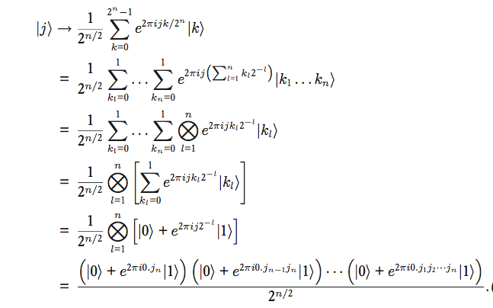
Product Representation
Little algebra gives
Proof
(Yeah.. I’m not doing that!)

Slide 7
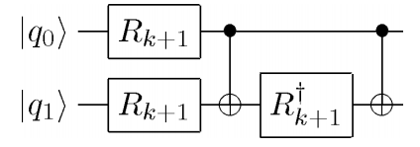


The $R_{k}$ Gate
$R_{k}=\left[\begin{matrix}1 & 0 \\ 0 & e^{2πi/2^{k}}\end{matrix}\right]$
Since this is unitary, we can of course construct controlled-$R_{k}$ with CNOT and basic single qubit gates.
Will you give it a go? (MIT homework question!)

Slide 8

Quantum Fourier Algorithm
How do we make each terms?
1. Apply the Hadamard gate to produce $\frac{1}{\sqrt{2}}(\left|\left.0\right\rangle \right.+\left|\left.1\right\rangle \right.)$
2. Apply the controlled-$R_{k}$ gate n-1 times for $\left|\left.j_{1}\right\rangle \right.$. (Control: $j_{2}$ to $j_{n}$, obviously)
3. Repeat for $\left|\left.j_{k}\right\rangle \right.$. For $\left|\left.j_{k}\right\rangle \right.$, apply the gate for n-k times.

Slide 9
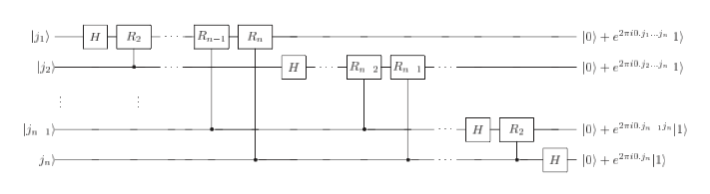
Visualisation
Note! The Hadamard gate MUST be applied at all basis kets!

Slide 10
Question.
1. Construct the 3-qubit QFT (Not Quantum Field Theory!) using H, S, and T gates.
2. Compare the efficiency of the classical FFT algorithm and the QFT algorithm. How many operations (approximately) should each algorithms do when they operate on n bases?

Slide 11
Phase Estimation
A unitary operator can have some complex phases as the eigenvalue, with the phase value unknown.
Of course, the overall process is close to an approximation, as we all know that the phase itself is an ‘exponential’ term.
Our Goal: Shor’s Algorithm

Slide 12

The Oracle
Sometimes called as a ‘black box’
capable of preparing the state |u⟩ and performing the controlled-$U^{2j}$ operation
The usage of oracles are NOT algorithms; they are more close to subroutines or modules.
They are normally combined with other procedures to perform some useful tasks. (e.g. Search Algorithms – Next Seminar!)

Slide 13
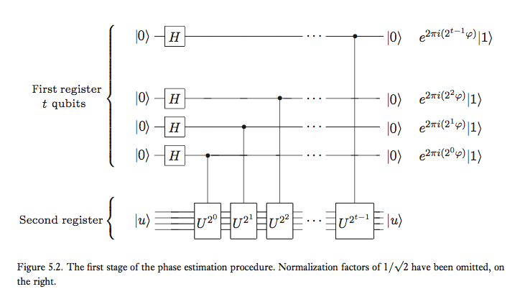
First Stage

Slide 14
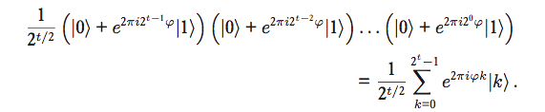
First Stage
Obviously, the overall state after the first state is given as
The last part is the product representation.

Slide 15

Second Stage
Remember
When we mark $φ=φ_{1}φ_{2}…φ_{t}$, the formula we saw in the last slide changes to ]
Okay! Let’s apply the inverse Quantum Fourier Transform and we are done!

Slide 16
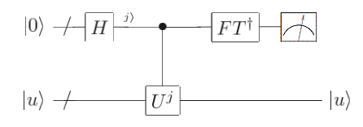
Schematic Diagram
Note. As you can easily deduce, this is an ESTIMATION of the phase until the nth order in binary.
Of course, the more qubits you have in the first register, the more precise the measurement gets.*
* To acquire the phase accurately to n bits with success rate $1−ε$ requires $t=n+log(2+\frac{1}{2ε})$ registers.

Slide 17
RSA Encryption
Easy explanation: The conventional algorithm for secure data transmission using number theory (i.e. Primes)
It’s hard to factorise composites rather than to multiply primes!
How much efficient?: The FASTEST classical factorisation algorithm operates at sub-exponential time scale.

Slide 18

Order-Finding
Order (Number Theory): The order of x modulo N is defined as the smallest integer such that $x^{r}≡1 \left(mod N\right)$
Question: Prove that for n<r, $x^{n}$s have different modulos.
Think of a unitary operator such tat U |y⟩ ≡ |xy(mod N )⟩
IF y is larger than N, by convention, U is identity for y larger than N.

Slide 19

Order-Finding
Think $\left|\left.u_{s}\right\rangle \right.=\frac{1}{\sqrt{r}}\sum_{k=0}^{r−1}{e^{−2πisk/r}\left|\left.x^{k} mod N\right\rangle \right.}$.
$U\left|\left.u_{s}\right\rangle \right.=\frac{1}{\sqrt{r}}\sum_{k=0}^{r−1}{e^{−2πisk/r}\left|\left.x^{k+1} mod N\right\rangle \right.}=e^{2πis/r}\left|\left.u_{s}\right\rangle \right.$
Okay! Now we have to approximate the eigenvalues!
I know you will have questions regarding this formalism. Let me explain.

Slide 20

Computing the Modular Exponentiation Algorithm
Question. Can we implement controlled-$U^{2j}$ operations with reasonable (i.e. not exponential) amount of gates?
It is. If you are curious, look at Box 5.2 at Nielsen & Chuang or http://qudev.phys.ethz.ch/content/courses/QSIT11/presentations/QSIT-ShorTheory.pdf (ETH Zurich lecture PPT)
Result: The overall performance can be made using $O(L^{3})$ gates.

Slide 21


Preparing $\left|\left.u_{s}\right\rangle \right.$
Wait..does preparing $\left|\left.u_{s}\right\rangle \right.$ require having knowledge on s?
We can avoid this problem using $\frac{1}{\sqrt{r}}\sum_{s=0}^{r−1}{\left|\left.u_{s}\right\rangle \right.}=\left|\left.1\right\rangle \right.$.
Apply the Phase Estimation Algorithm: for each s in the range 0 through r − 1, we will obtain an estimate of the phase φ ≈ s/r

Slide 22

Continued Fraction Algorithm
Let’s reduce the order-finding algorithm to phase estimation.
Continued Fraction: $\left[a_{0},a_{1},…, a_{m}\right]=a_{0}+\frac{1}{a_{1}+\frac{1}{a_{2}+\frac{1}{…+\frac{1}{a_{m}}}}}$.
Theorem. Suppose s/r is a rational number such that $\left|\frac{s}{r}−φ\right|<\frac{1}{2r^{2}}$. Then s/r is a convergent of the continued fraction for φ, and thus can be computed in O(L3) operations using the continued fractions algorithm.
Using this, s/r can be quickly approximated, thus giving r with a reasonable accuracy.

Slide 23
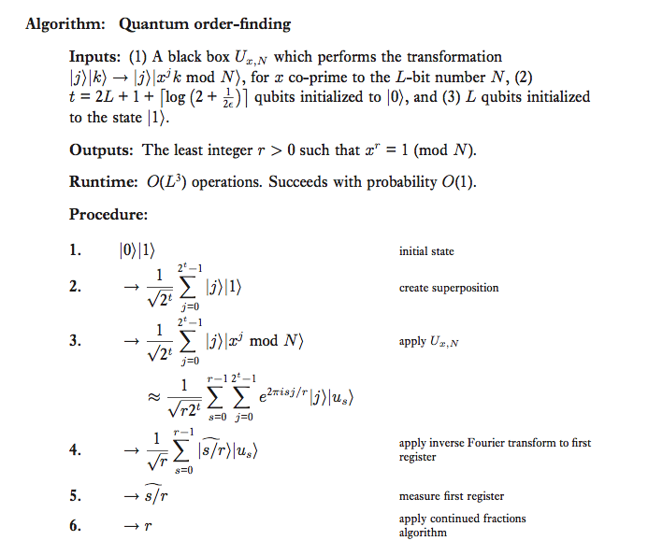
Summary

Slide 24

Factoring
You all know what factoring is.
Our task: Reduce the factoring problem to an order-finding problem.
Step 1. Show that we can compute a factor of N if we can find a non-trivial solution $x≠ ± 1(mod N)$ to the equation $x^{2} = 1(mod N)$.
Step 2.

Slide 25

Two Important Theorems
Theorem 1. Suppose N is an L bit composite number, and x is a non-trivial solution to the equation $x^{2} = 1\left(mod N\right)$ in the range 1 ≤ x ≤ N. Then at least one of gcd(x−1,N) and gcd(x+1,N) is a non-trivial factor of N that can be computed using O($L^{3}$) operations.
Theorem 2. Suppose $N=p_{1}^{α_{1}}p_{2}^{α_{2}}…p_{m}^{α_{m}}$, which is the prime factorisation of odd N. Let x be an integer chosen uniformly at random, subject to the requirements that 1 ≤ x ≤ N − 1 and x is co-prime to N . Let r be the order of x modulo N. Then $p\left(r even and x^{\frac{r}{2}}≠−1 \left(mod N\right)\right)≥1−\frac{1}{2^{m}}$.

Slide 26

Shor’s Algorithm
1. If N is even, return the factor 2.
2. Determine whether $N=a^{b}$. If so, return a. (This can be done using classical computers.)
3. Randomly choose x in the range 1 to N −1. If gcd(x, N) > 1 then return the factor gcd(x, N ).
4. Use the order-finding subroutine to find the order r of x modulo N.
5. If r is even and $x^{r/2}≠−1 (mod N)$, then compute $gcd\left(x^{\frac{r}{2}}−1, N\right),gcd\left(x^{\frac{r}{2}}−1, N\right)$ and test whether these have some non-trivial factors.

Slide 27

Validity of Shor’s Algorithm
Step 1 & 2 either returns a factor, or provide that $N=p_{1}^{α_{1}}p_{2}^{α_{2}}…p_{m}^{α_{m}}$.
Step 3 and 4 generates the random number and computes the order r.
For Step 5, the second theorem first guarantees that r is even and $x^{r/2}≠−1 (mod N)$ with at least 1/2 chance.
Then, the first theorem shows that either $gcd\left(x^{\frac{r}{2}}−1, N\right),gcd\left(x^{\frac{r}{2}}−1, N\right)$ will have a non-trivial factor.

Slide 28

Questions
1. Factoring 91: Suppose we wish to factor N = 91. Confirm that steps 1 and 2 are passed. For step 3, suppose we choose x = 4, which is co-prime to 91. Compute the order r of x with respect to N, and show that $x^{r/2}mod 91 = 64 ̸= − 1(mod 91)$, so the algorithm succeeds, giving gcd(64 − 1, 19) = 7.
2. Using the contents you have learnt, factorise 15 quantum mechanically. This process was physically implemented using NMR.

Slide 29
More information on Shor’s Algorithm
http://www-bcf.usc.edu/~tbrun/Course/lecture15.pdf
https://courses.cs.washington.edu/courses/cse599d/06wi/lecturenotes11.pdf
https://www.cl.cam.ac.uk/teaching/2006/QuantComp/lecture7.pdf
See these three notes to understand the algorithms better.
See https://www.uwyo.edu/moorhouse/slides/talk2.pdf on how to factorise large numbers.

Slide 30
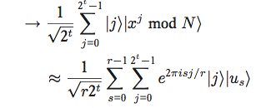
Period Finding
For a function f(x+r)=f(r), can we find a period for this function using quantum algorithms?
Yes, and we can do it using Phase Estimation.
Remember at the order-finding algo.
The Phase can be estimated using the continued fractions method, just as before.

Slide 31
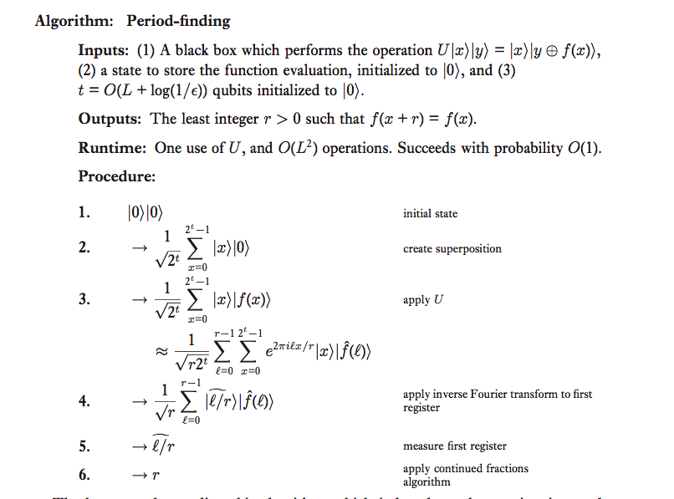
Period Finding

Slide 32

Discrete Logarithms
Little more complex version of the Period Finding Algo.
Think $f\left(x_{1},x_{2}\right)=a^{sx_{1}+x_{2}}$.
This is definitely periodic in 2D (Period (l, -ls))
Also, this poses the question If $b=a^{s}$ while a, b are given, what is s? (Discrete Logarithm Problem)
Quite expectedly, this is basically the 2D version of Period finding.

Slide 33
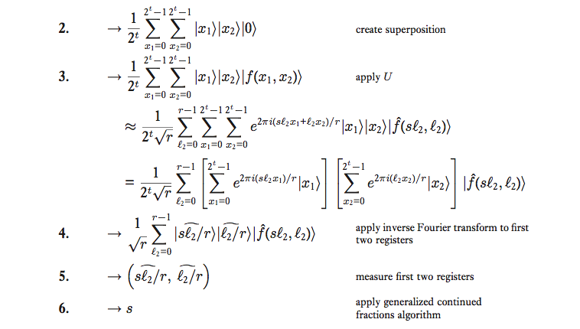
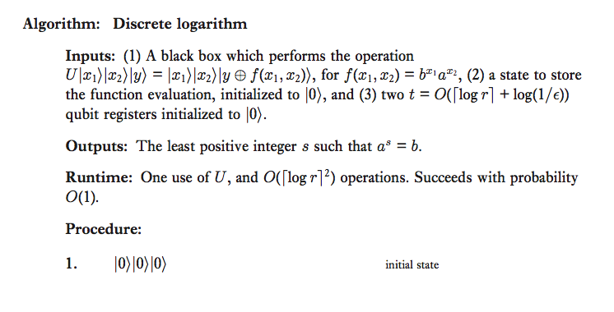
Discrete Logarithms

Slide 34
The Hidden Subgroup Problem
The generalisation for all the work we have done.
In Group Theory Language: Let f be a function from a finitely generated group G to a finite set X such that f is constant on the cosets of a subgroup K, and distinct on each coset.
Given a quantum black box for performing the unitary transform U|g⟩|h⟩ = |g⟩|h⊕f(g)⟩, for g ∈ G, h ∈ X, and ⊕ an appropriately chosen binary operation on X, find a generating set for K.

Slide 35
The Hidden Subgroup Problem
For finite or finitely generated Abelian groups, log G gates can effectively solve this problem.
The Hidden Subgroup problems are usually extremely hard to solve.
For example, what if there is a group where the continued fraction expansion does not work?

